Slide 1
Senior Project (GolemSlasher)
Poggers5Head(Isaac Peterson and Dallas Baker)

Slide 2
In The Beginning…

Slide 3
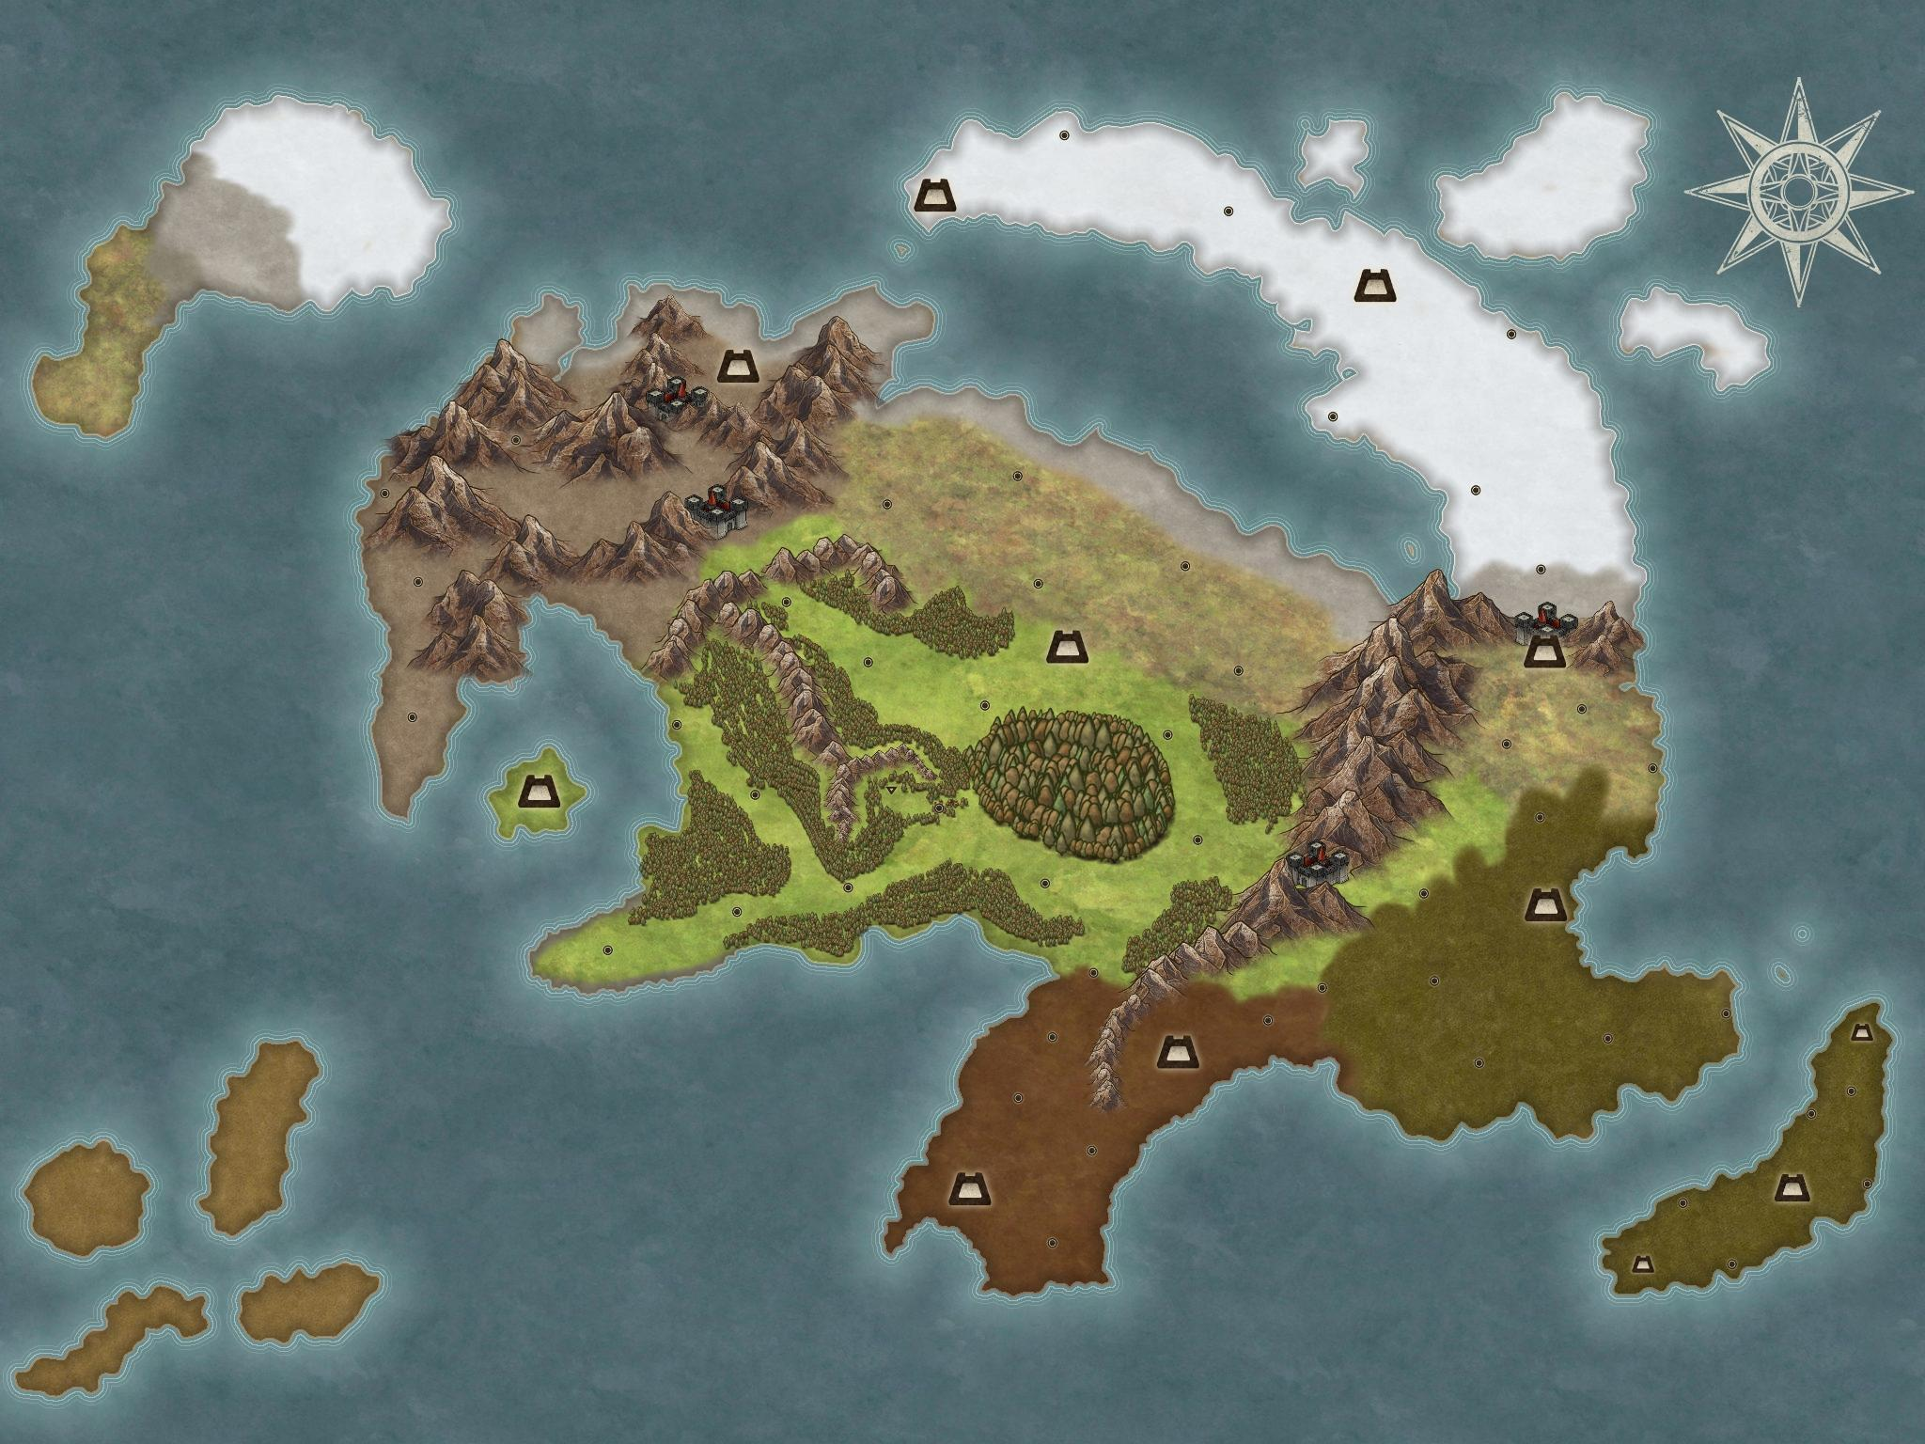
Early Ideas
Originally our idea was an Open-World RPG.
Original designed characters and weapons.
Dungeons Around the Open-World
Towns with a few interactable NPCs

Slide 4
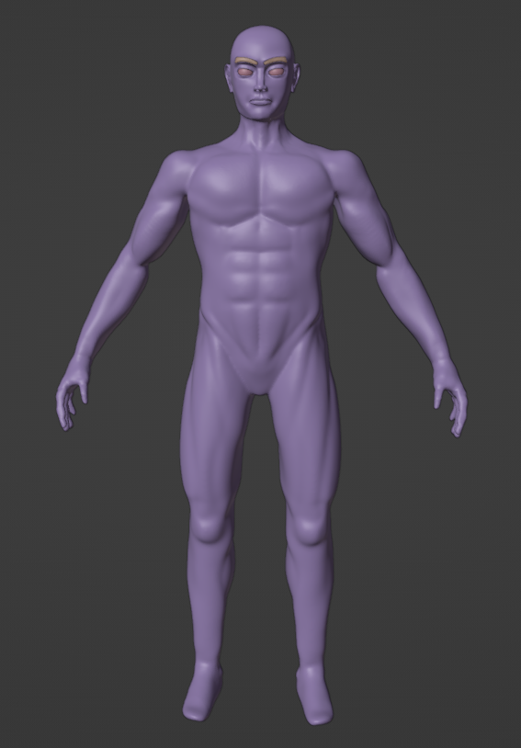
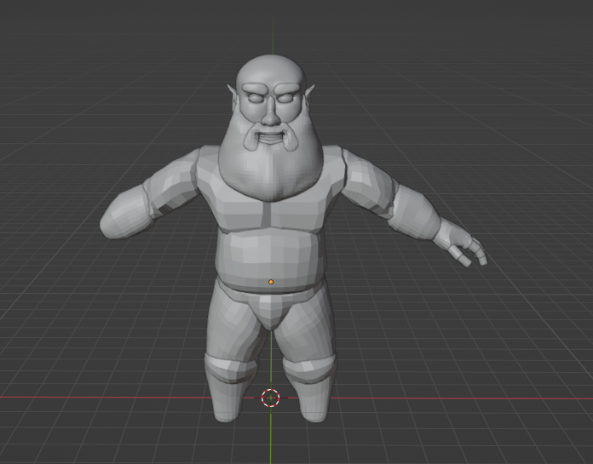
Setbacks…
These are the models for the player and one of the first NPCs. This was for our earlier idea of our game.
Due to time constraints the models would not be completed or implemented.
Two sprints of time went into these models and created a delay.

Slide 5
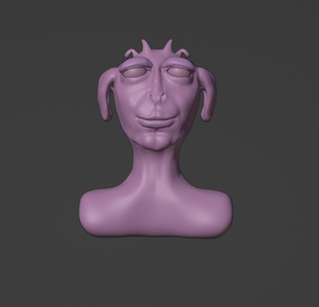
This is Steve…
Steve was not really part of the game development originally and was just a way to test out sculpting techniques for the player earlier in the project. But Steve is nonetheless a member of this process so…here he is!

Slide 6
Changes Were Made

Slide 7
Summary of Changes
Due to the delay from trying to originally create our own assets we needed some premade assets to help us regain that time lost in our sprints. We also decided that create a giant world was a bit ambitious for the time frame we had. So now we could focus on some map design while also creating the game mechanics we needed for a functional game.

Slide 8
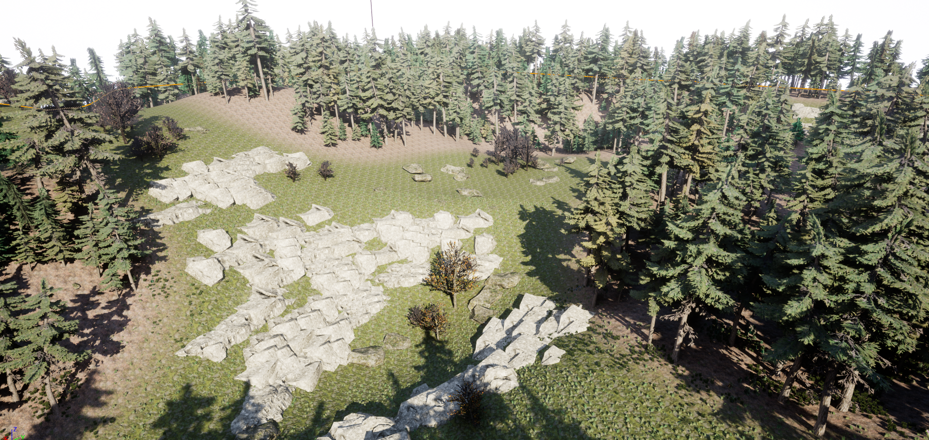
The Map

Slide 9
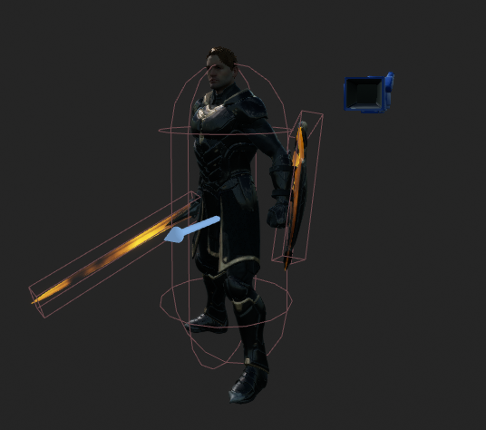
The Player
This is the current player in our project. He is a Paragon asset that can be downloaded for free on the Epic Marketplace. Animations were already created, but we still needed to create animation montages and loops to use along with the basic camera and capsule collider.
The sword and shield collider were made to help create damage and defense logic. Only damage logic was implemented though.

Slide 10
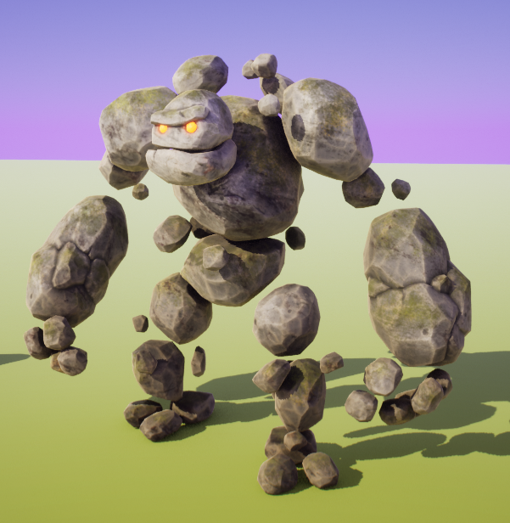
The Enemy Golem
This was another premade asset that we used, this one had a more difficult time to implement as we had to use blendspaces, blackboards, behavior tree, with blueprint scripting on top of all that and it still is a little… buggy.

Slide 11
Blueprints In Depth

Slide 12
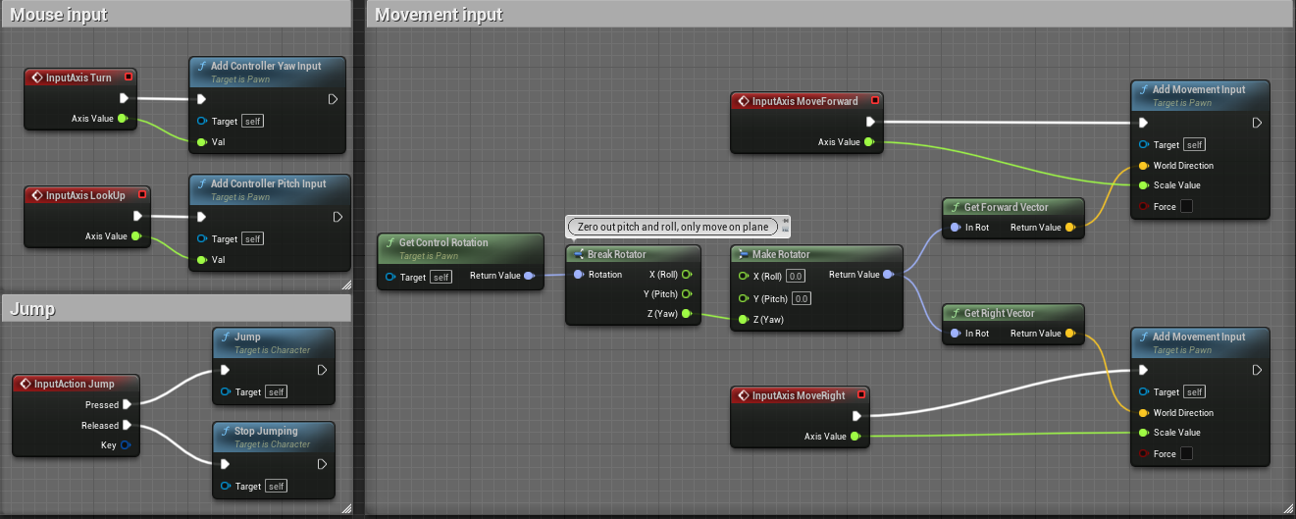
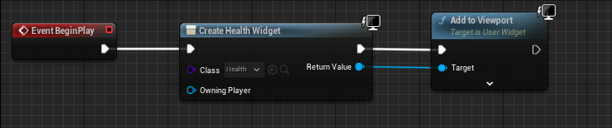
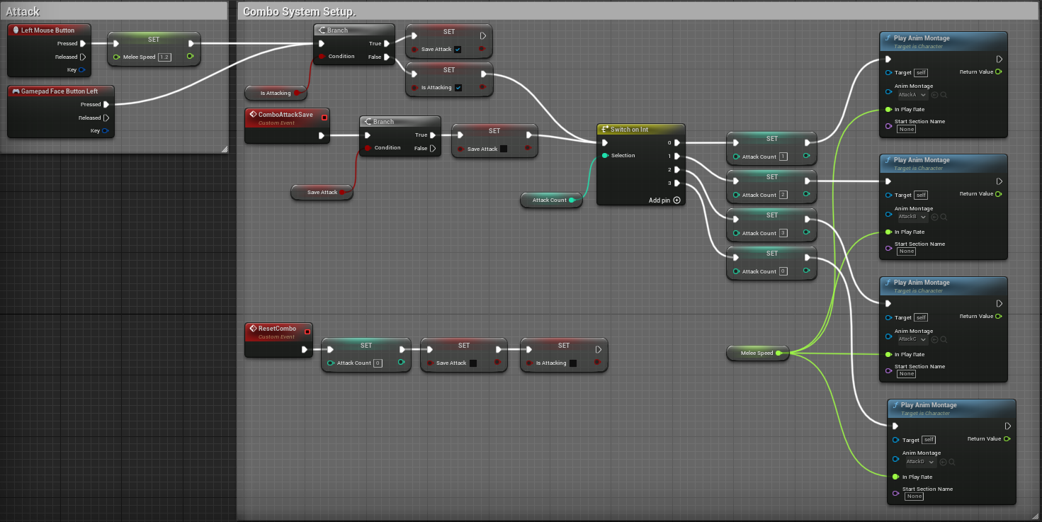
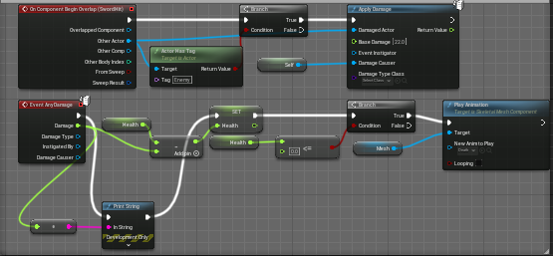
Character

Slide 13
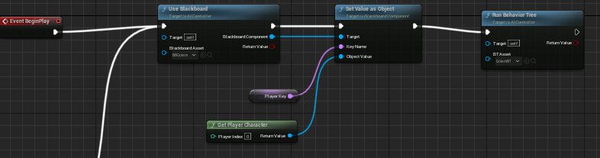
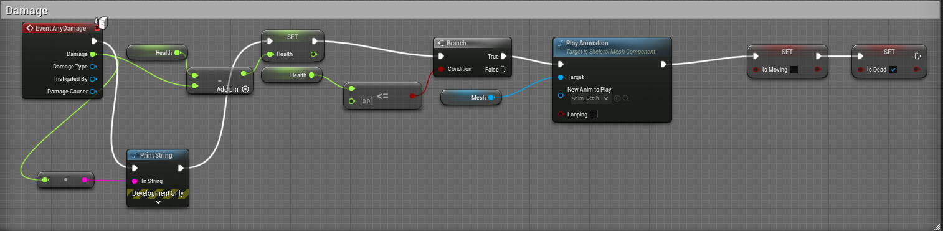
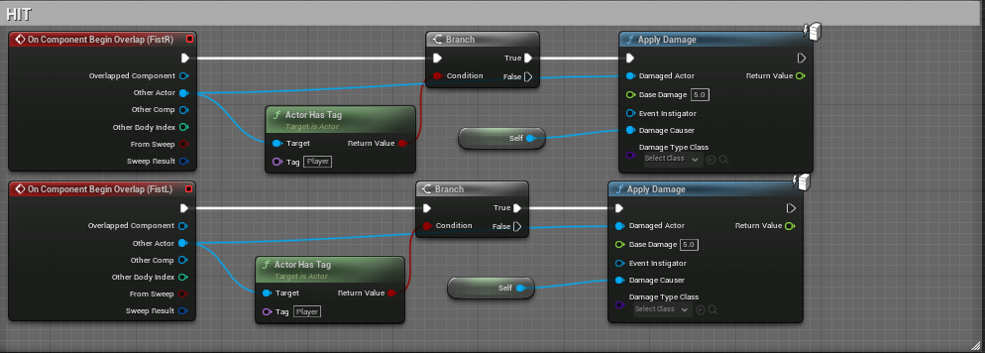
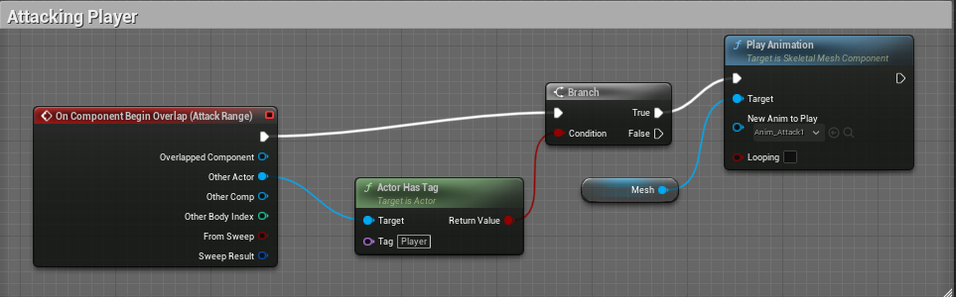
Golem

Slide 14
Ending Notes and Demo

Slide 15
Most Challenging Processes
Trying to get The AI and the player to interact. Both were easy to implement separately but when we tried to have them interact with each other, it became harder to keep track of animations, and the AI attacking the player. Our animation logic broke when the player attacked the enemies and the enemies could almost instantly kill the player if we walked into the wrong collisions.

Slide 16
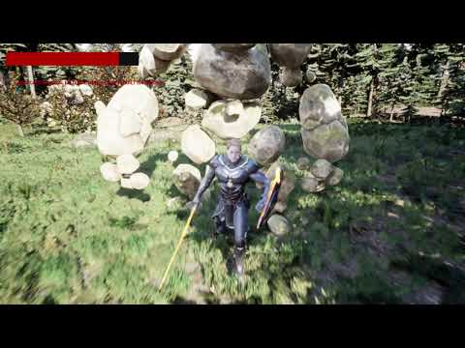
Video Demonstration

